Slide 1





CAN WE PREDICT BACKORDER? JC Penny (Supply Chain Data)
Salil Chawla, Atharva Nandurdikar , Piyush Srivastava, Anil Thadani, Siddharaj Deshmukh

Slide 2
WHAT IS BACKORDER?
Sometimes when a company makes an order for a good, a company or store may have run out of stock in its inventory. A company who has run out of the demanded product but has re-ordered the goods would promise its customers that it would ship the goods when they become available. A customer who is willing to wait for some time until the company has restocked the merchandise, would have to place a back order. A back order only exists if customers are willing to wait for the order.
A customer order that cannot be filled when presented, and for which the customer is prepared to wait for some time. The percentage of items backordered and the number of backorder days are important measures of the quality of a company's customer service and the effectiveness of its inventory management.

Slide 3
ABOUT DATA
We have selected the data of JC Penny (Global Garment Supply Chain Data) from datahub
In total, it consists 23 attributes out of which 6 are binary, 1 notation and the other 16 are numeric.
Among the attributes, some represents the status of transiting, like: lead time of the product (lead-time, as weeks) and amount of product in transit from source (in transit qty, units).
This data represents product supplier’s historical performance. Some suppliers have not been scored and have a dummy value of -99 loaded.
brief explanation and data types of the 23 attributes

Slide 4
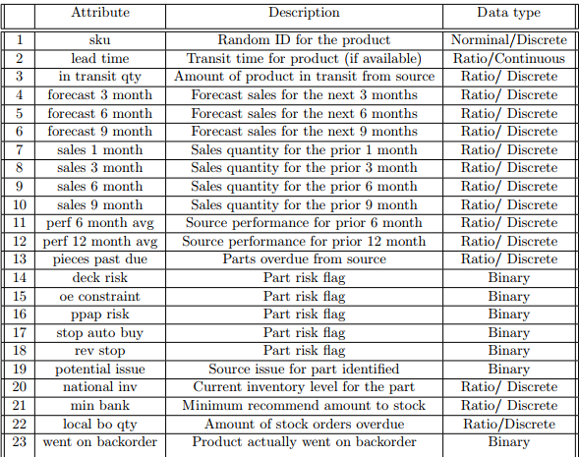
ATTRIBUTES

Slide 5

DATA ISSUES
Knowing from the data,1% of the products actually went on backorder, which creates a big imbalance on the classes.
It is a common problem for a real dataset.
Preferably, it is required that a classifier provides a balanced degree of predictive accuracy for both the minority and majority classes on the dataset. However, in many standard learning algorithms, it is found that classifiers tend to provide a severely imbalanced degree of accuracy

Slide 6
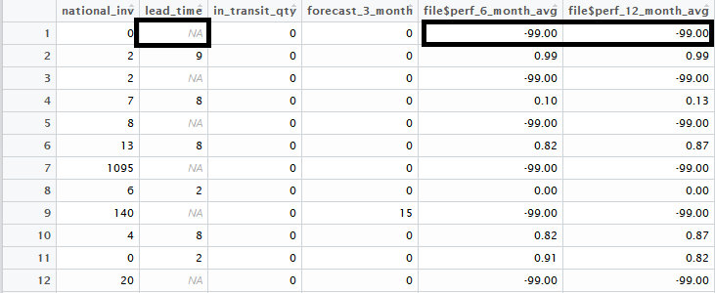
Initial Dataset

Slide 7
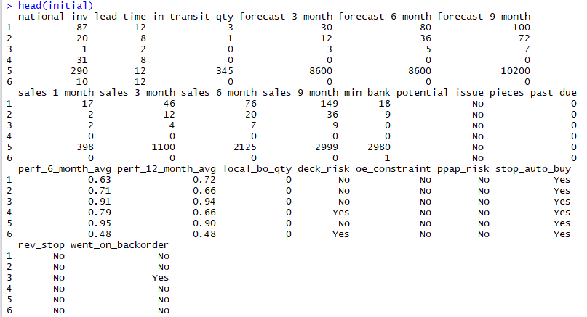
First few rows (not normalized but NA values filled Using KNN)
Mention: Assumption is that min and max values are the only ones possible
and hence used that for normalization.

Slide 8
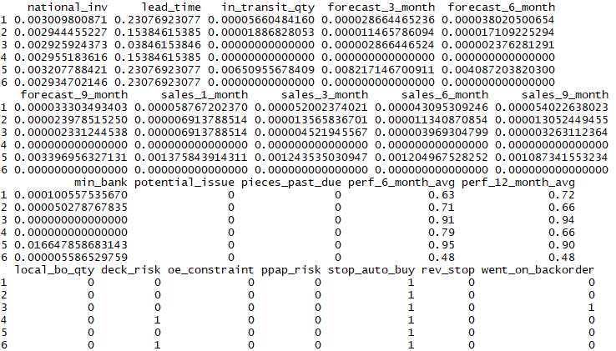
Normalized dataset

Slide 9
Variable selection
After cleaning the data, we started applying the models on different combination of variables.
Accuracy of KNN model when applied over all the variables was 77%.
Need to select particular combination of variables for better accuracy.
Variable selection technique is very effective technique to fetch best set of variables for a model.
First step is to check which variables are ‘correlated’.

Slide 10
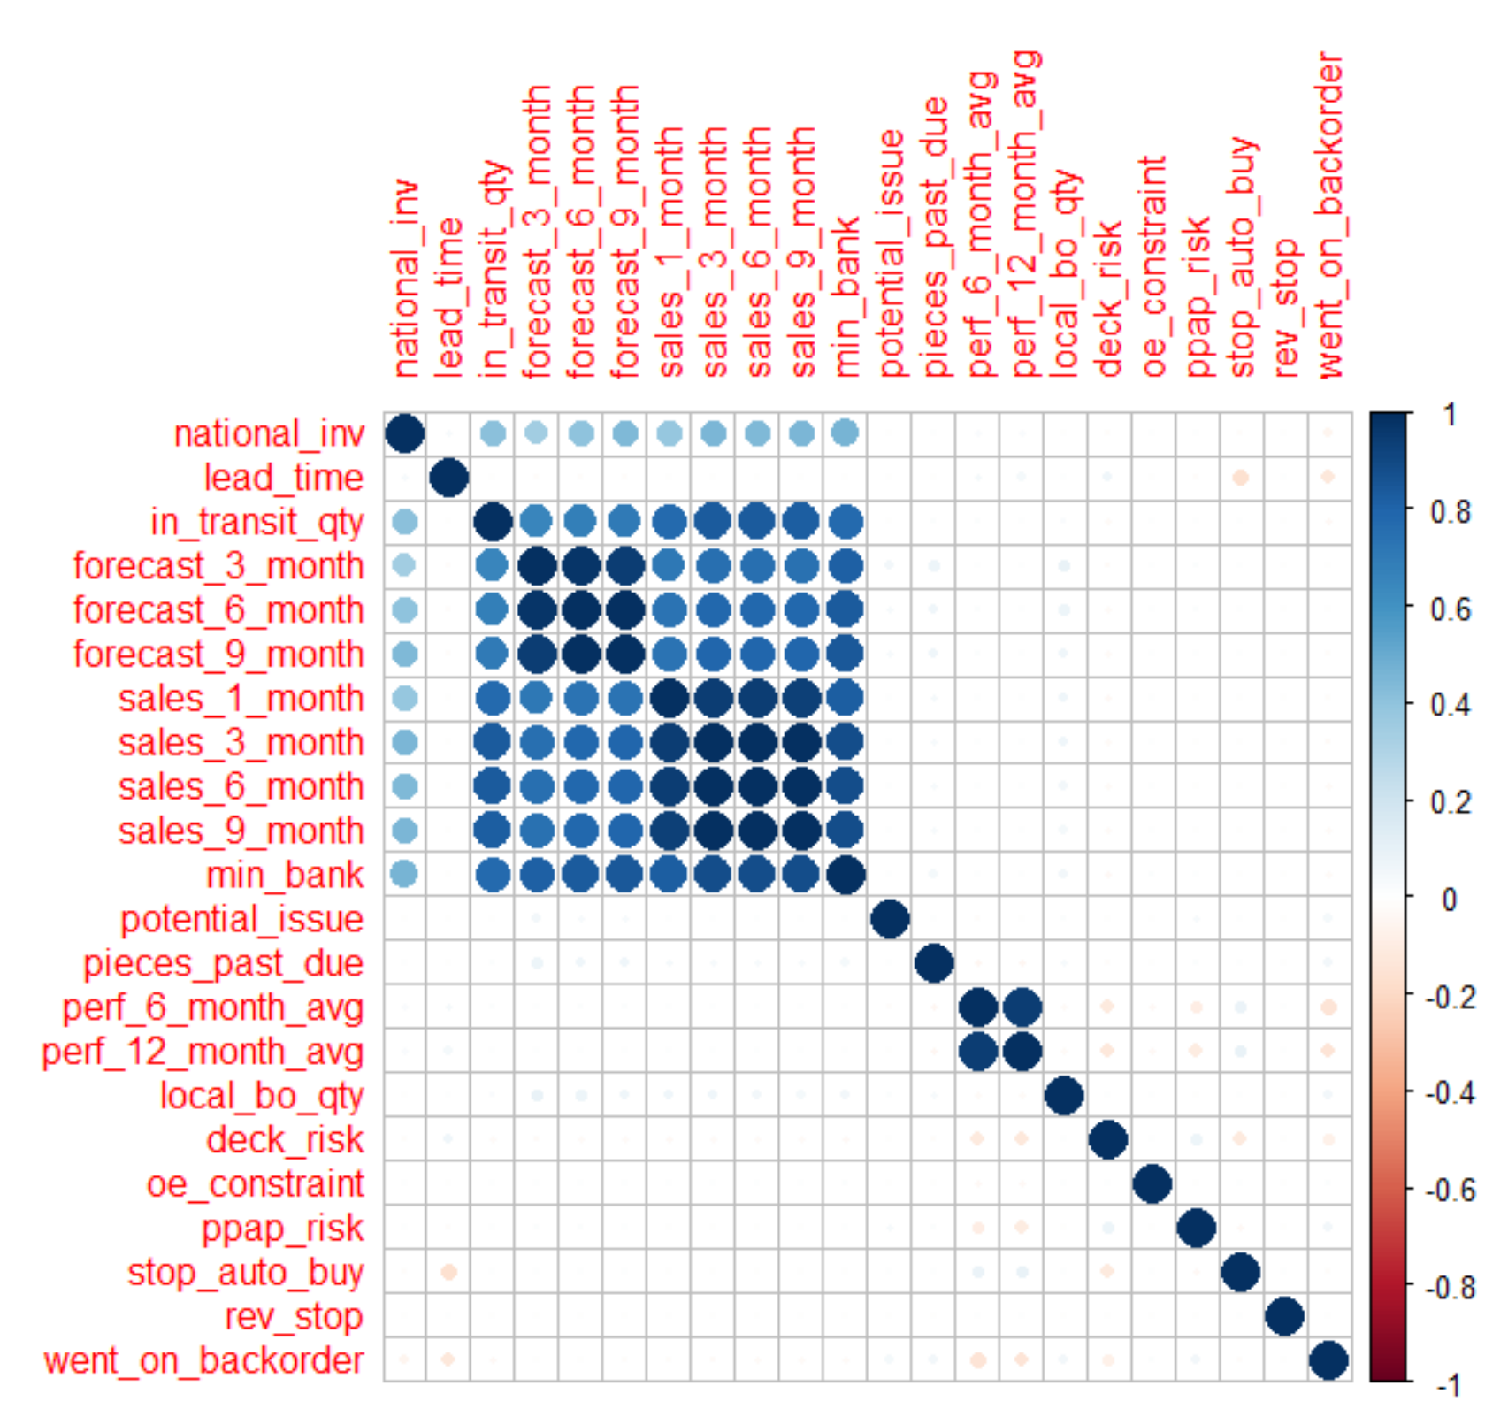
Correlation Among Variables

Slide 11
Findings of Correlation
The dark Blue circles forming a diagonal line show that, a variable is highly correlated with itself.
However, there is high correlation between two sets containing three variables each viz. forecast_3, 6 & 9_months and sales_1, 3,6,& 9_month.
Choosing one variable from each of these sets will reduce multi-correlation and in turn increase the accuracy of model.
If there are K potential Independent Variables, there are 2^{k} distinct subsets to be tasted.
How to choose best set of variables for a model?
What are different techniques for variable selection?
To be continued…

Slide 12
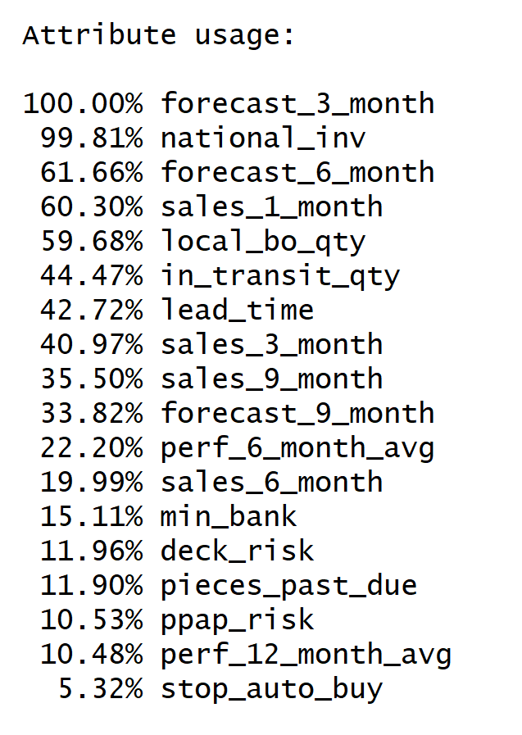
C 5.0 for Variable Selection
C 5.0 was Implemented over complete dataset to analyze decision trees.
It measured predictor importance by determining the percentage of training set samples that fall into all the terminal nodes after the split.
First two predictors ‘national_inv’ ‘forecast_3_month’ in the first split automatically bears 100% importance.
Based on the best ‘category’ contained in an attribute, other variables are ranked as shown in adjoining figure.
Notes:
To be changed by Atharva...

Slide 13
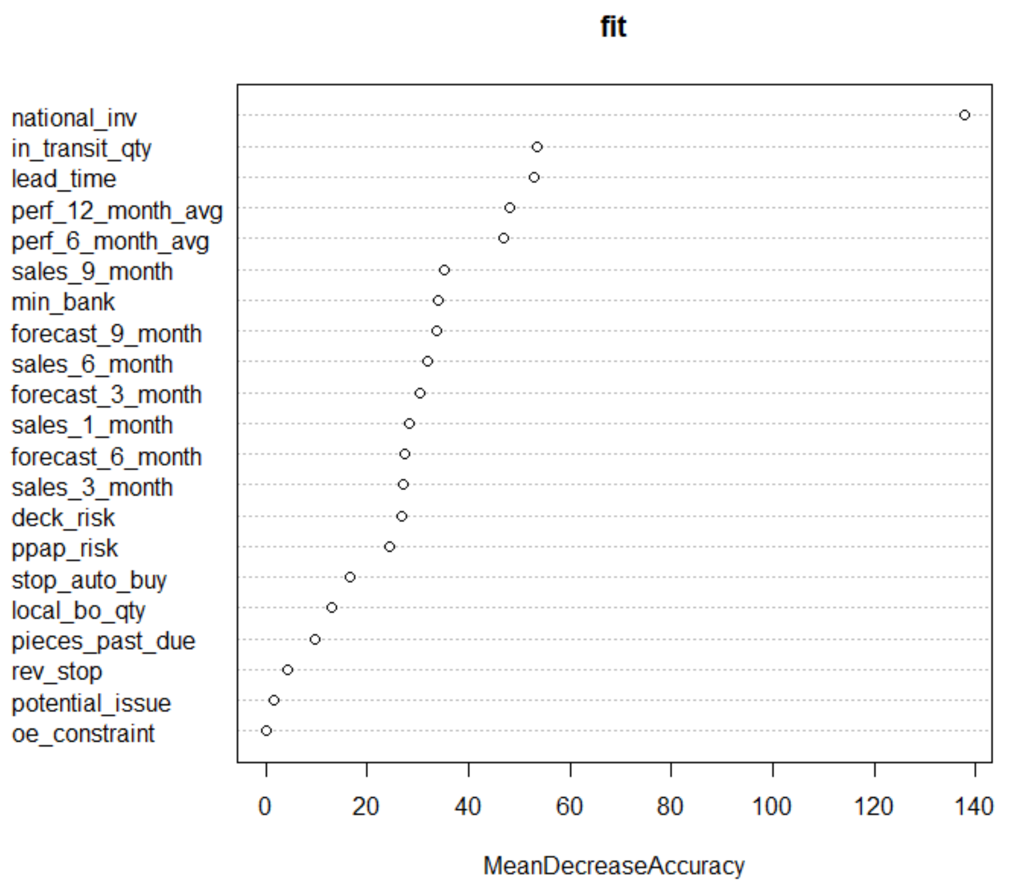
Random Forest for Variable Selection
To get better accuracy, we applied random forest which decorrelated 200 trees (classifiers) generated on different bootstrapped samples from Training data.
Averaging the trees helped us to reduce ‘variance’ & avoid ‘overfitting’.
The out of bag estimate was calculated to find mean prediction error on each training sample.
The graph shows attributes in decreasing order of ‘Mean decrease accuracy’.
Hence final variable set selected for all further models is:
'national_inv', 'in_transit_qty', 'lead_time', 'forecast_3_month', 'sales_1_month', 'min_bank’,
'perf_6_month_avg’,'local_bo_qty','stop_auto_by’, ’deck_risk','went_on_backorder'

Slide 14
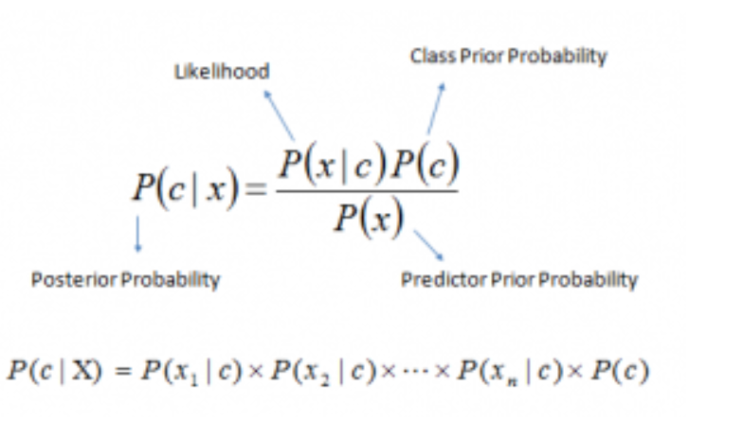
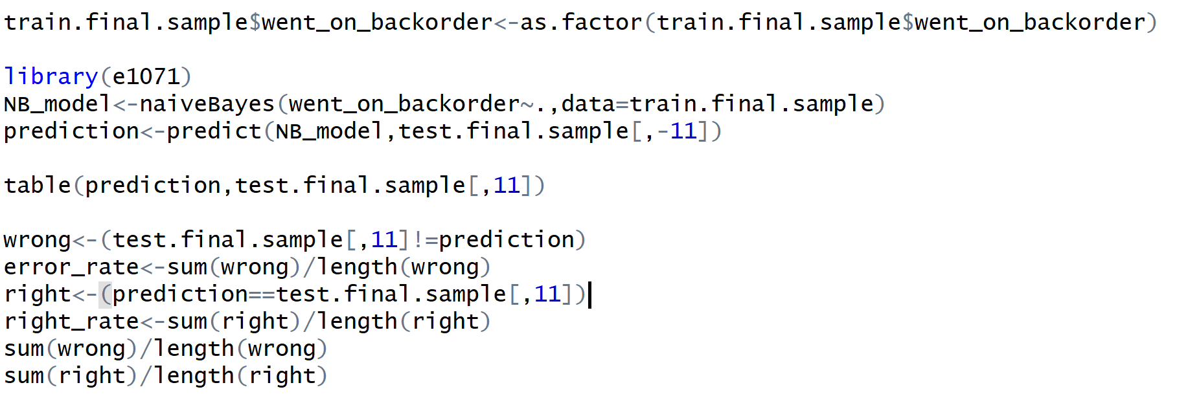
Naive Bayes
It calculates the posterior probability for each class.
The class with the highest posterior probability is the outcome of prediction.
Assumption:
It works based on the frequency count of each variable, so variables are
independent of each other.
P(c|x) is the posterior probability of class (c, target) given predictor (x, attributes).
P(c) is the prior probability of class.
P(x|c) is the likelihood which is the probability of predictor given class.
P(x) is the prior probability of predictor.

Slide 15
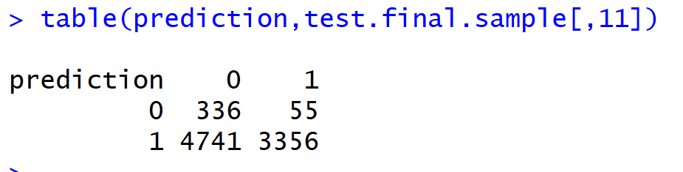
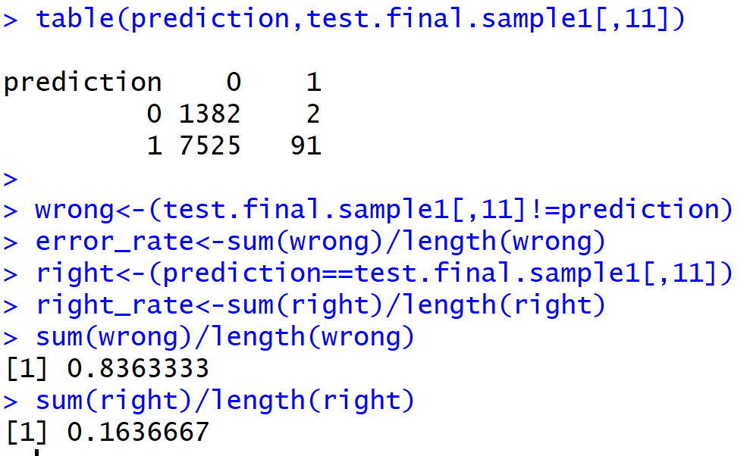
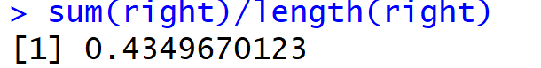
Naïve Bayes Result
Balanced Dataset
Confusion Matrix:
Highly Imbalanced Dataset
Accuracy :

Slide 16
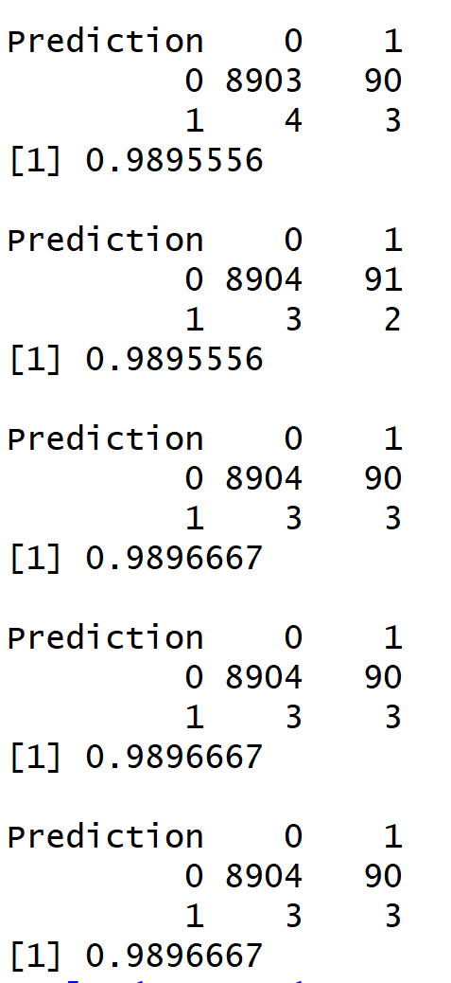
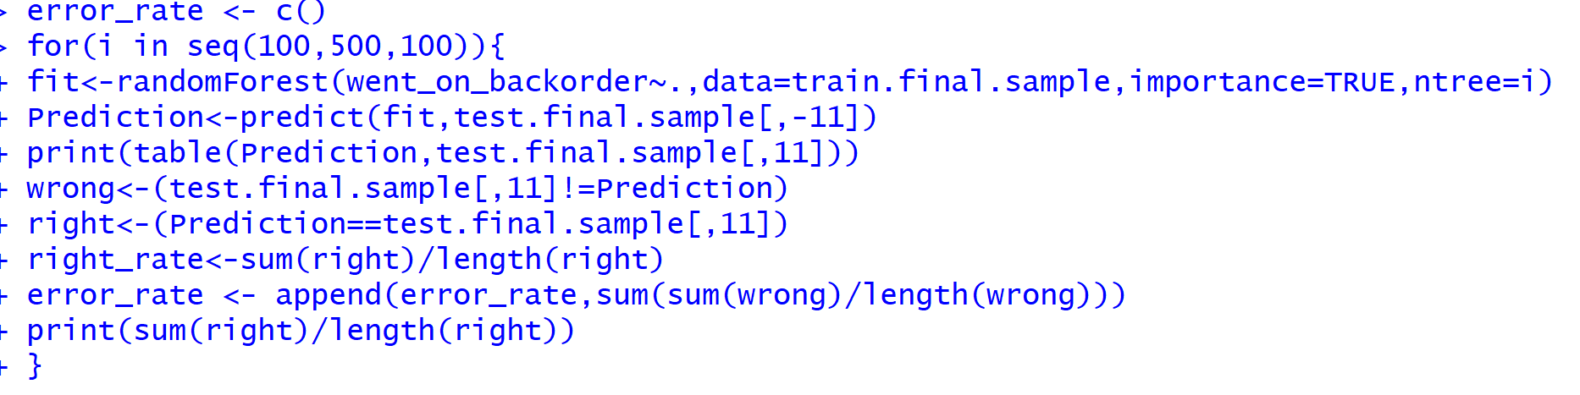
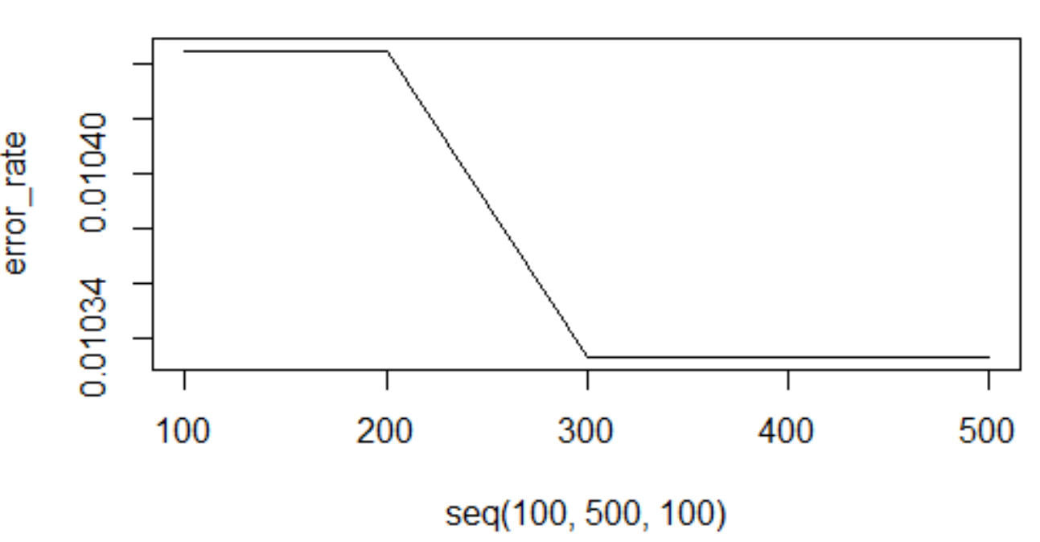
Random Forest
First applied on Highly Imbalanced data and then tried to Balanced it.
Results on Highly Imbalanced data:
Used Random Forest because it performs well on classification
model, and it doesn’t require data to be normalized,
correlation doesn’t matter and works on binary split.
We have tried to overcome the overfitting if any.

Slide 17
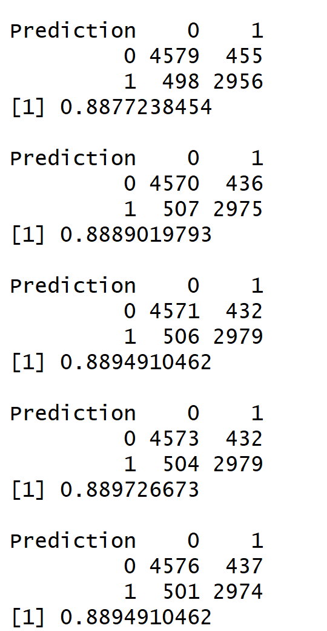
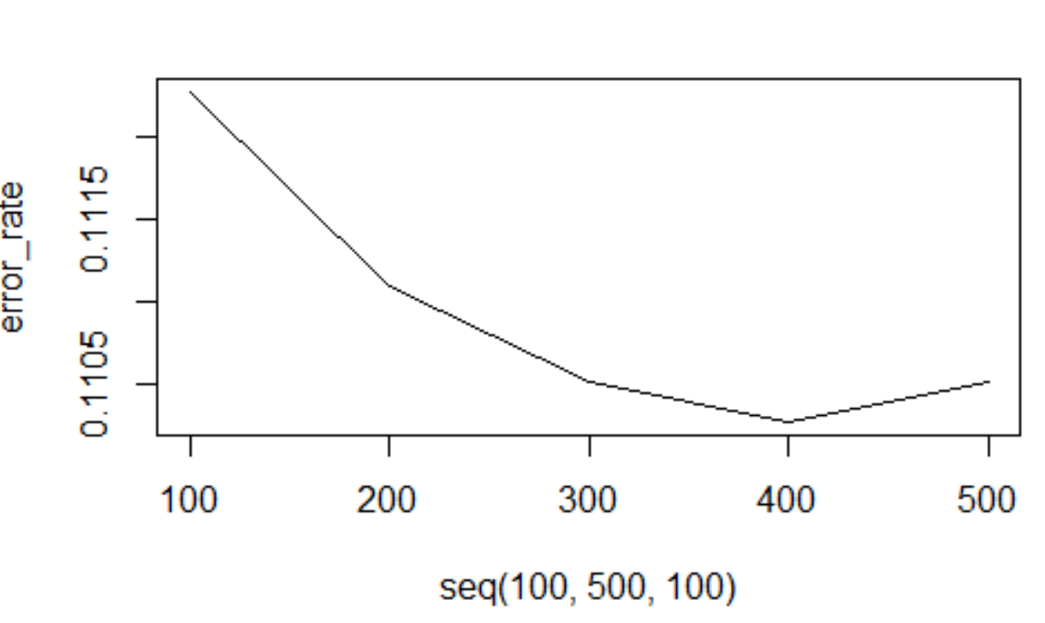
Randomly selects 2/3 of training dataset as training and 1/3 as validation internally
for each tree.
Random Variable selection – Square root of total number of all predictors for classification.
Picks Best Split and classify leftover data(1/3) on each tree.
Chooses the best classification having most votes over all the trees in the forest.
Best tree with minimum error Rate is coming at 400 with
accuracy of 88.97%.
Confusion Matrix
and Accuracy
ERROR RATE FLOW

Slide 18
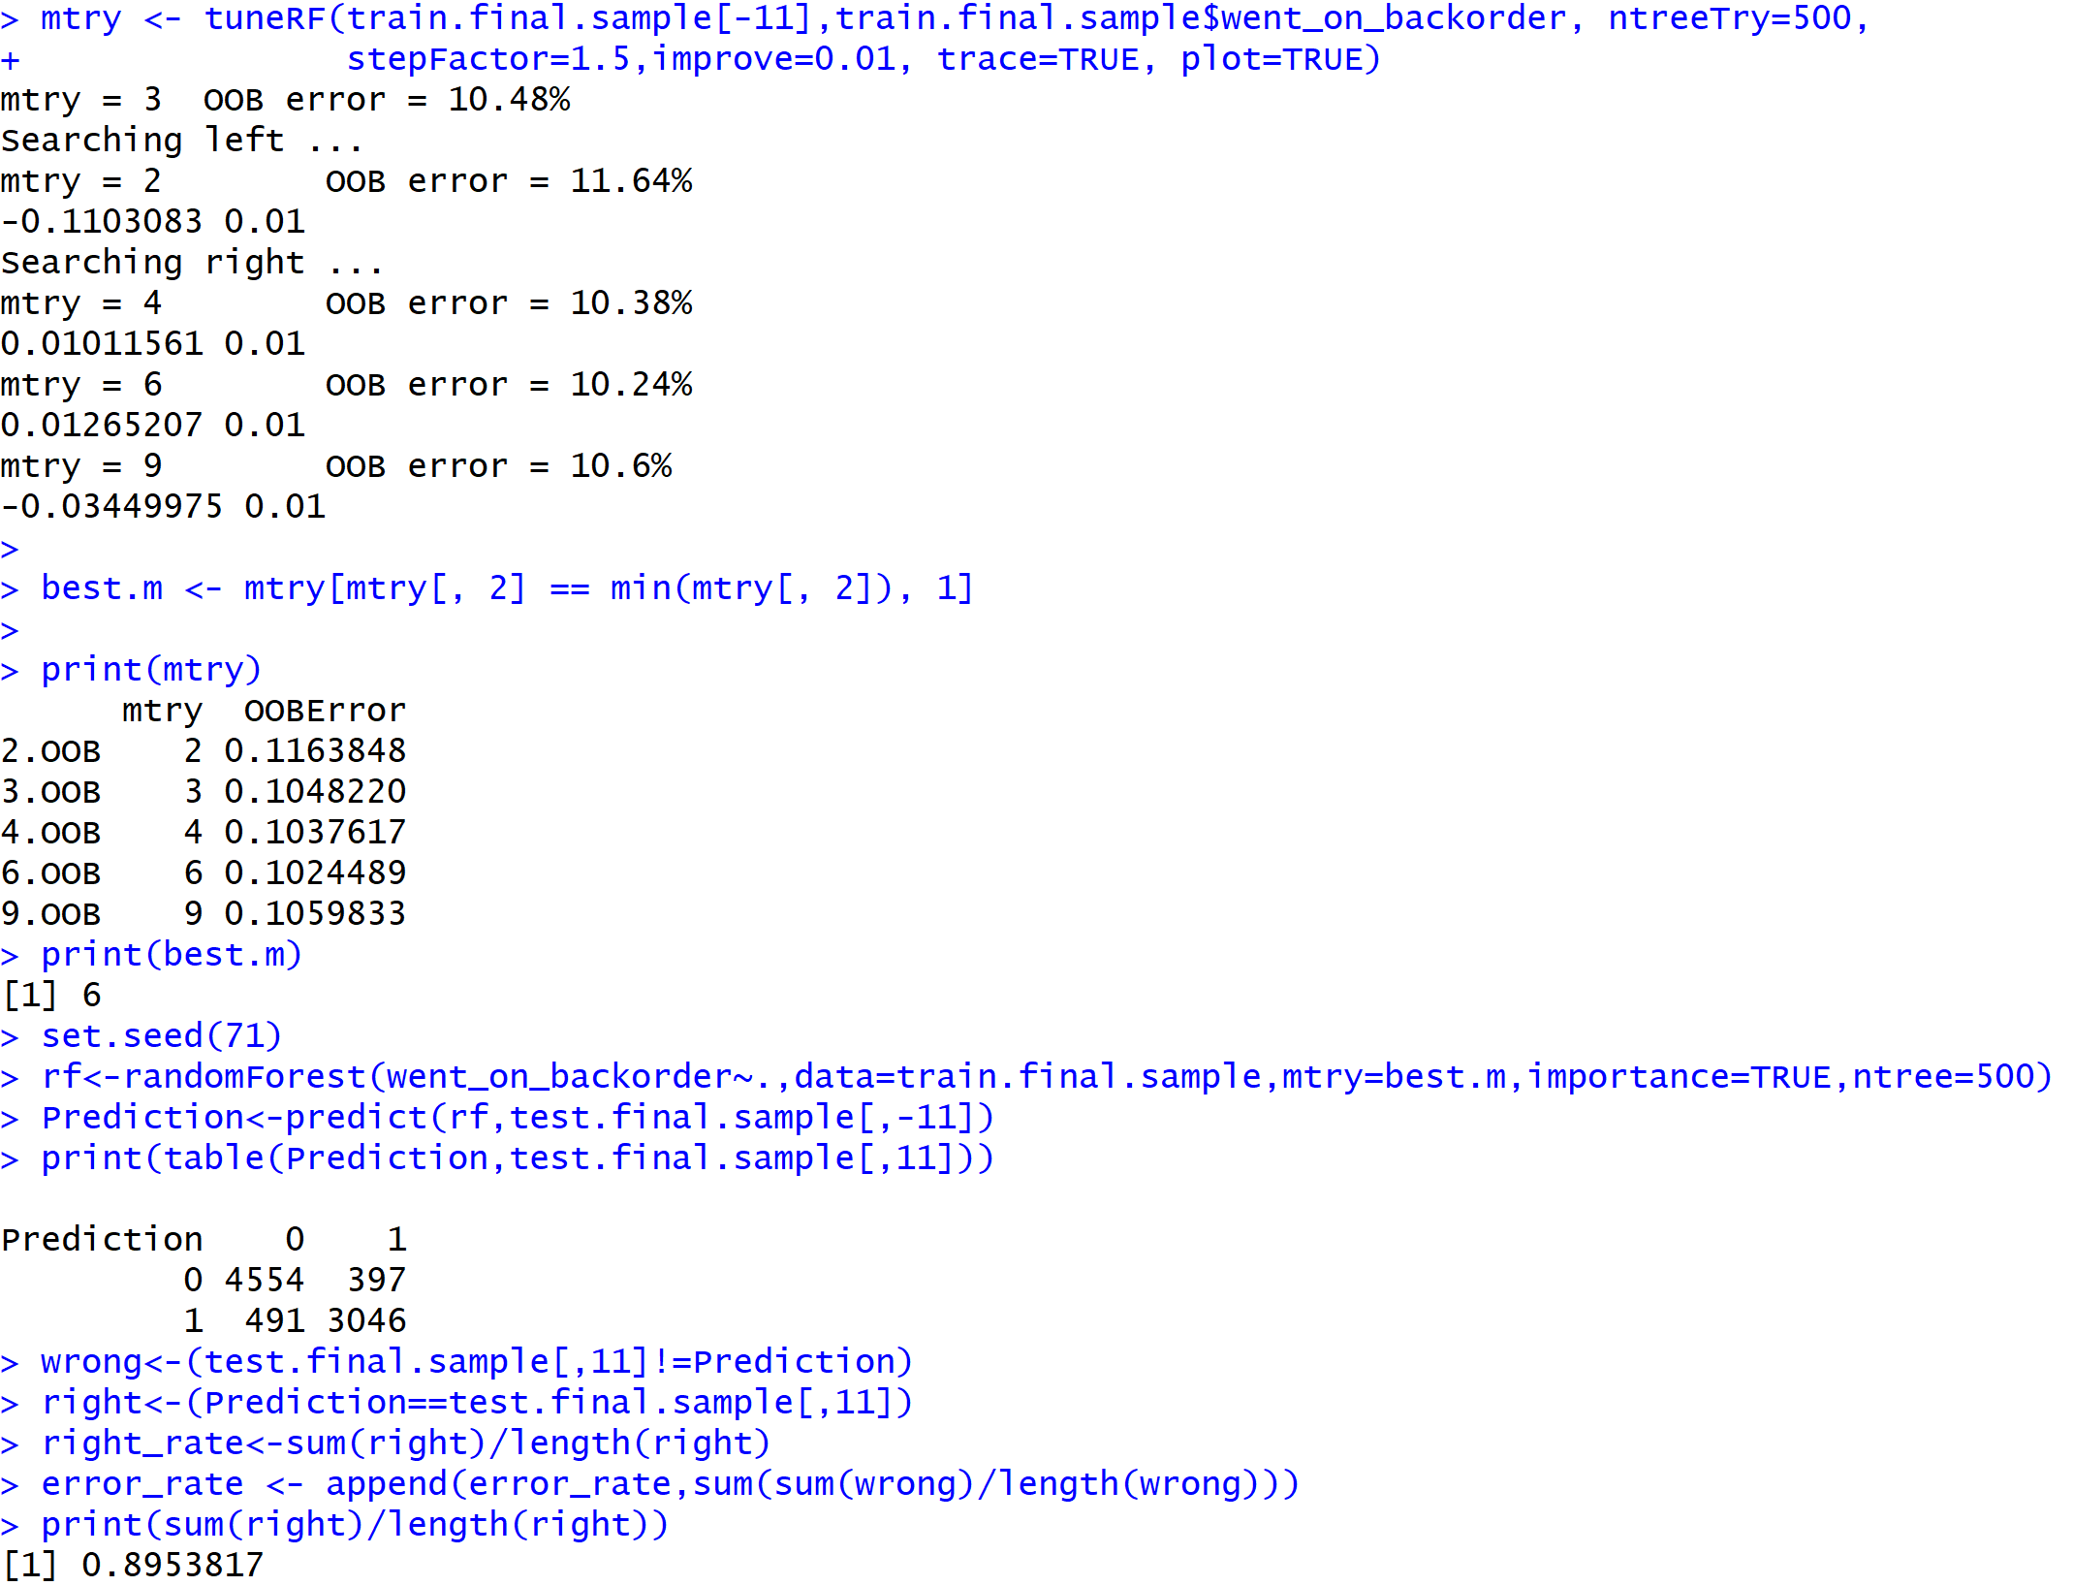
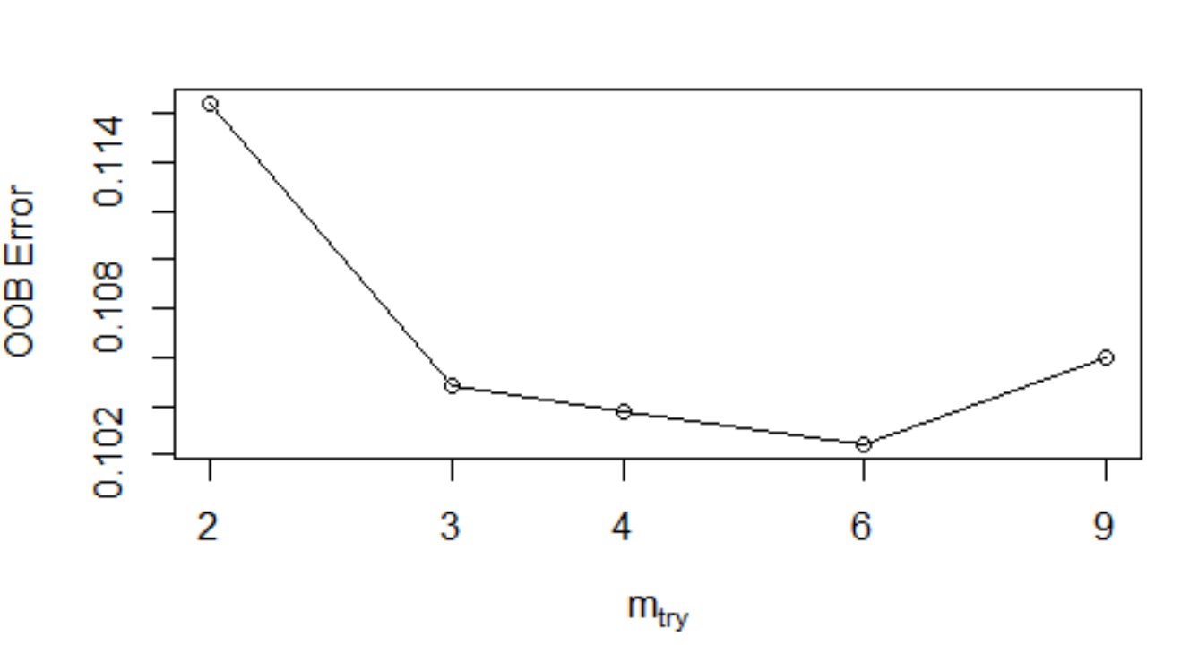
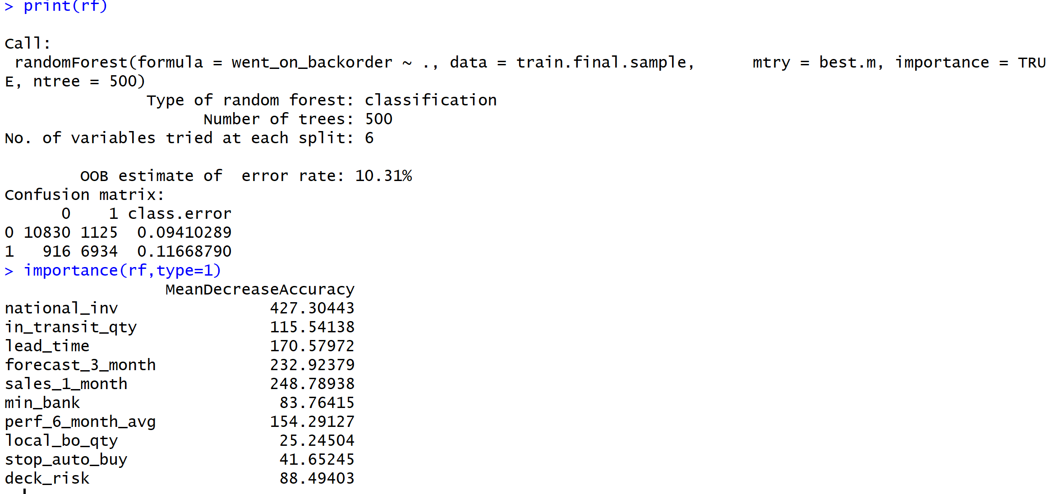
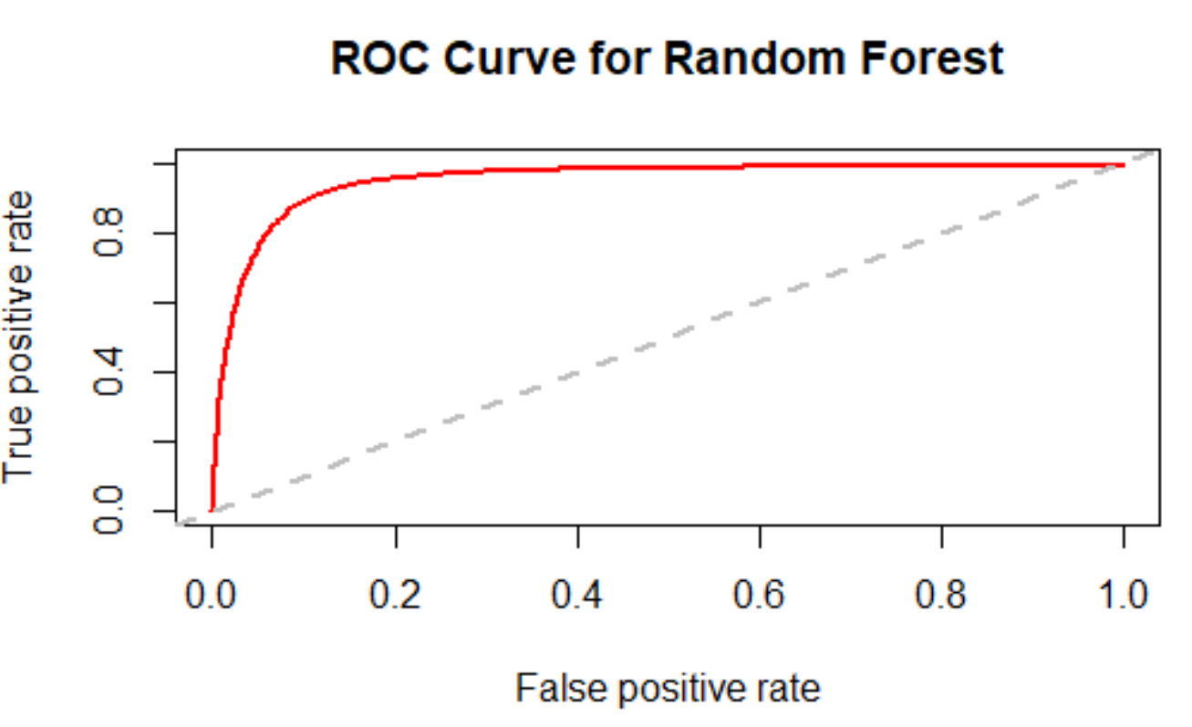
Tuned Random Forest
We tried to find the optimal mtry and ntree where the out of bag error rate stabilizes and reach minimum.
We got at ntree=500, mtry=6

Slide 19
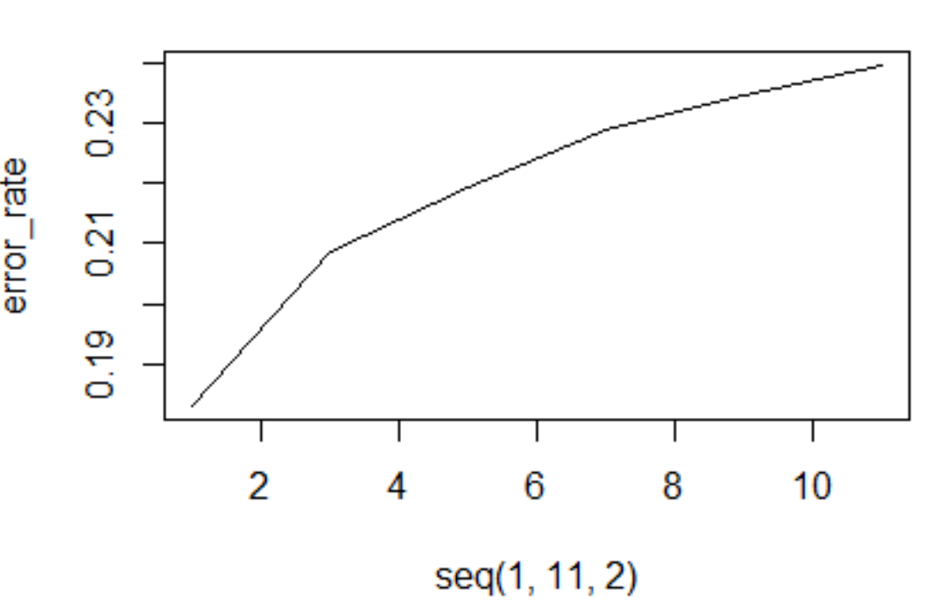
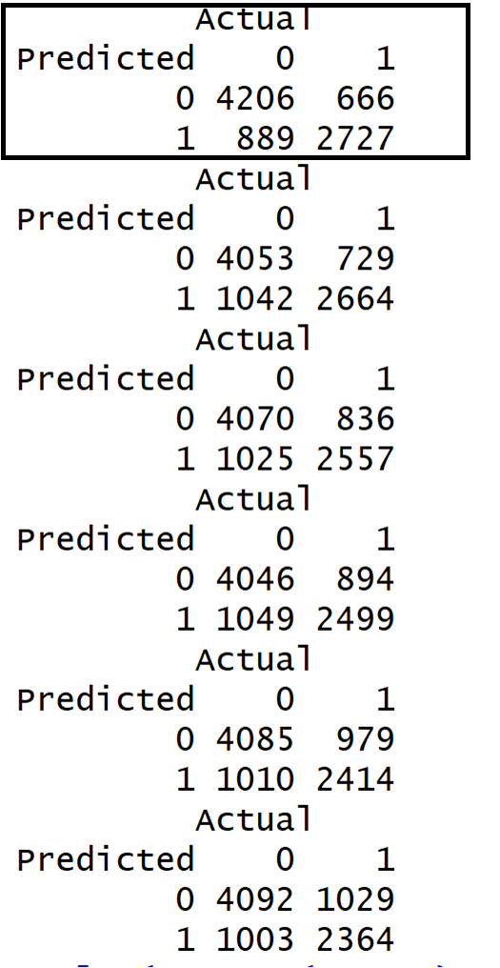
Applying Un-weighted kNN model (81.6%)
Notes:
We can conclude that k = 1 is our optimum value of k for both un-weighted and weighted kNN technique. We can also see the difference between both the techniques – For same values of k increase in accuracy for weighted kNN is more than unweighted kNN. This is because there are many values equidistant from a given a value and while un-weighted searches for one of them randomly, weighted kNN votes them according the weighted average.

Slide 20
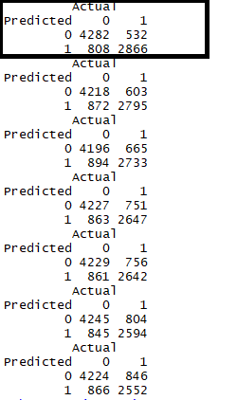
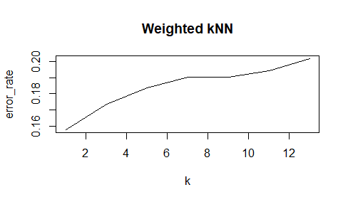
Applying Weighted kNN model (84.2%)

Slide 21
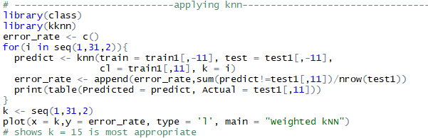
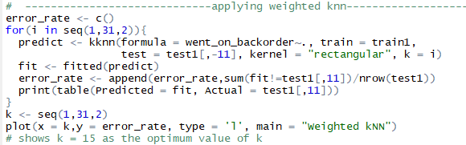
kNN Contd..

Slide 22
Applying Neural Network model
Although it is not mandatory to normalize the data, normalizing helps the algorithm reach global minima with higher probability.
Due to lack of convergence for neurons 3 and further we increased stepmax and threshold values.

Slide 23
Accuracy of Neural Network (47-50%)
Optimal no. of hidden layers were found to be 2
Trying with un-normalized values made little change in the results – accuracy decreased.

Slide 24
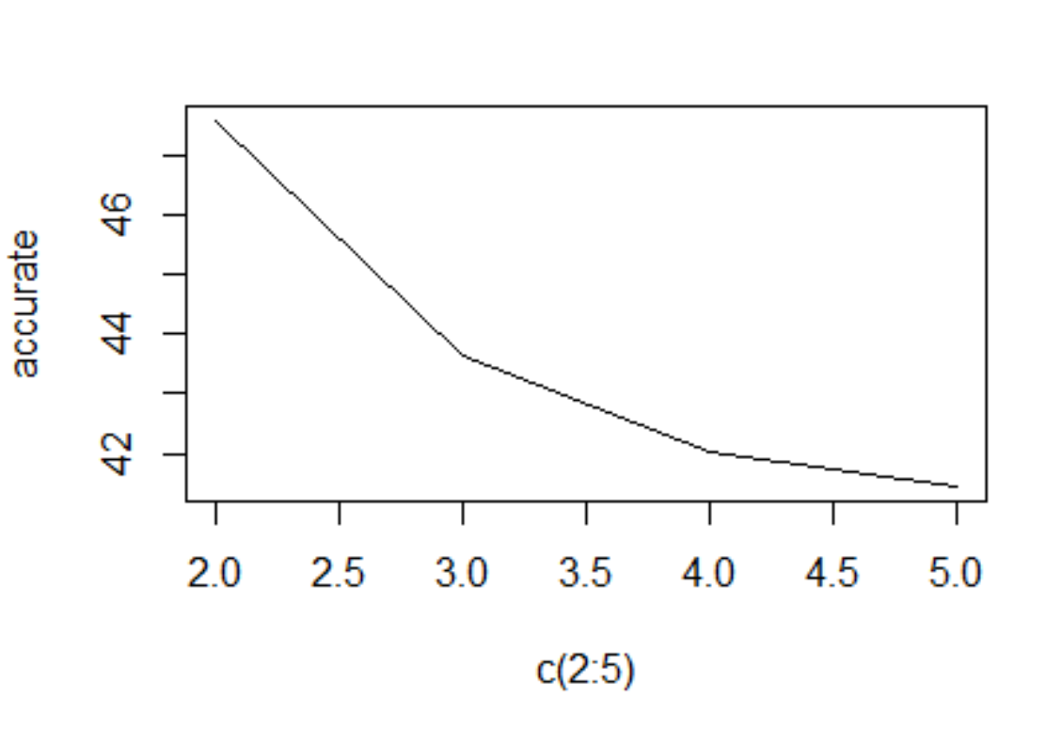
Graph of Accuracy
Values of neurons:

Slide 25
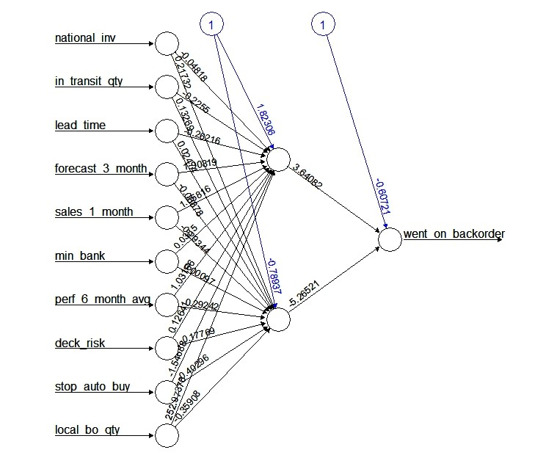
Neural Network diagram

Slide 26
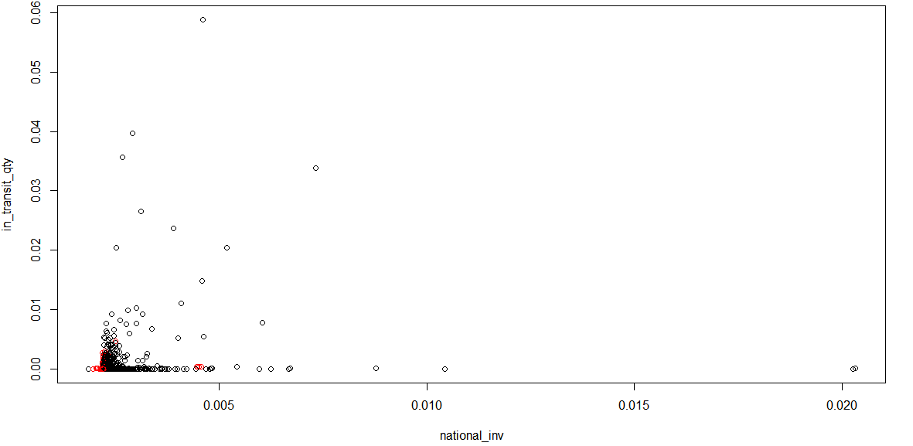
Why clustering may not be good for our data!!

Slide 27
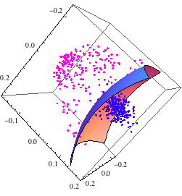
Support Vector Machine

Slide 28
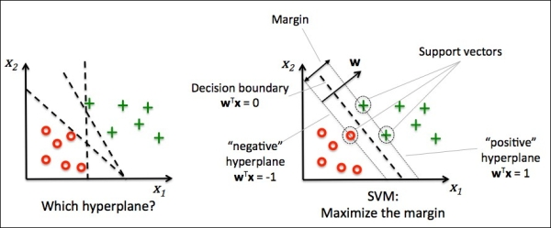
What is Support Vector Machine ?
Support Vector Machine” (SVM) is a supervised machine learning algorithm which can be used for both classification or regression challenges. However, it is mostly used in classification problems.
In this algorithm, we plot each data item as a point in n-dimensional space (where n is number of features you have) with the value of each feature being the value of a particular coordinate.
Then, we perform classification
by finding the hyper-plane that
differentiate the two classes
very well.

Slide 29
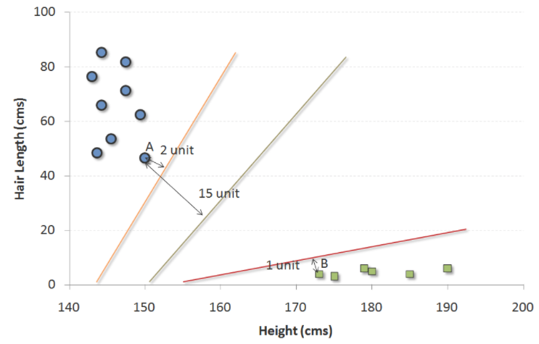
Maximal-Margin Classifier (hypothetical classifier)
The numeric input variables (x) in your data (the columns)
form an n-dimensional space. For example,
if you had two input variables, this would form a two-dimensional space.
B0 + (B1 * X1) + (B2 * X2) = 0
Where the coefficients (B1 and B2) that determine the slope
of the line and the intercept (B0) are found by the learning
algorithm, and X1 and X2 are the two input variables.
The distance between the line and the closest data points is
referred to as the margin
These points are called the support vectors.
They support or define the hyperplane.
By plugging in input values into the line equation, you can calculate whether a new point is above or below the line.
Above the line, the equation returns a value greater than 0 and the point belongs to the first class (class 0).
Below the line, the equation returns a value less than 0 and the point belongs to the second class (class 1).
A value close to the line returns a value close to zero and the point may be difficult to classify.

Slide 30
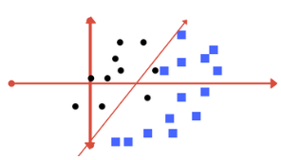
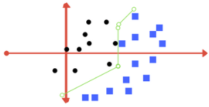
Soft Margin Classifier / Regularization parameter
This change allows some points in the training data
to violate the separating line.
The C parameters defines the amount of violation
of the margin allowed.
During the learning of the hyperplane from data, all training instances
that lie within the distance of the margin will affect the placement
of the hyperplane and are referred to as support vectors.
And as C affects the number of instances that are allowed to fall within the margin, C influences the number of support vectors used by the model.
The smaller the value of C, the more sensitive the algorithm is to the training data (higher variance and lower bias).
a very small value of C will cause the optimizer to look for a larger-margin separating hyperplane, even if that hyperplane misclassifies more points.
The larger the value of C, the less sensitive the algorithm is to the training data (lower variance and higher bias).
Large values of C, the optimization will choose a smaller-margin hyperplane if that hyperplane does a better job of getting all the training points classified correctly.

Slide 31
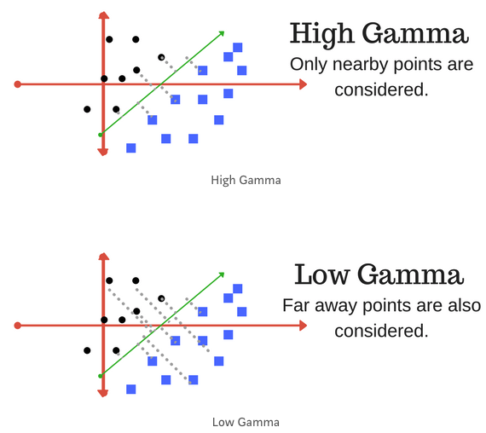

Gamma
The gamma parameter defines how far the
influence of a single training example reaches,
with low values meaning ‘far’ and
high values meaning ‘close’.
Kernel
A powerful insight is that the linear SVM can be
rephrased using the inner product of any
two given observations, rather than
the observations themselves. The inner product between
two vectors is the sum of the multiplication of each pair of input
values
The inner product of the vectors [2, 3] and [5, 6] is 2*5 + 3*6 or 28
Radial Kernel SVM (Radial basis function)
Finally, we can also have a more complex radial kernel. For example:
K(x,xi) = exp(-gamma * sum((x – xi^2))
Where gamma is a parameter that must be specified to the learning algorithm. A good default value for gamma is 0.1, where gamma is often 0 < gamma < 1. The radial kernel is very local and can create complex regions within the feature space, like closed polygons in two-dimensional space.

Slide 32
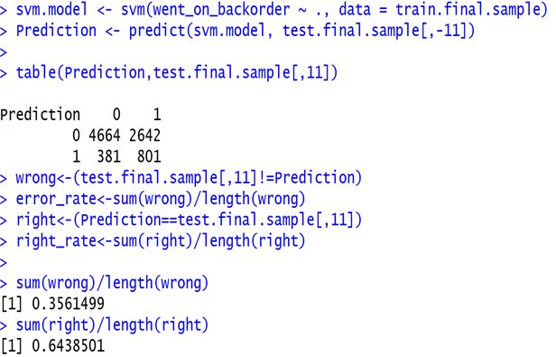
Data Preparation for SVM
How to best prepare training data when
learning an SVM model.
Numerical Inputs: SVM assumes that our inputs
are numeric. If we have categorical inputs
we may need to covert them to binary dummy variables (one variable for each category).
Binary Classification: Basic SVM is intended for binary (two-class) classification problems. Although, extensions have been developed for regression and multi-class classification.
R package : e1071 package

Slide 33
Business Recommendations:
National Inventory – Define min and max quantity levels at the national
Inventory level.
In Transit Quantity – Keep a track of amount of the product in transit from
the source, as delaying this would affect the business negatively.
Lead Time – Transit time required from the source needs to known well in
advance, and guaranteed.
Forecast 3 Months – Forecast Sales for the next 3 months of the product this
will help to avoid the product from going on backorder.
Sales 1 Month – Sales quantity for the prior 1 month gives us a good guess that how much quantity
would be expected in the current month.
Min_bank – A minimum recommended amount of stock needs to be defined.
Perf_6_moth_avg – Source performance for prior 6 month period from which the quantity is manufactured or is to be brought is to be considered to avoid backordering.
Local back Order Quantity: Quantity of the particular product that went on backorder in local markets should be studied.
Stop Auto buy : Auto buying of products needs to be kept in check, keeping inventory in perspective.
Deck Risk : The product lying on deck (in shop, in ship containers) needs to be considered.

Slide 34
Conclusion
Compared the accuracy of each algorithm
Random forest was the best algorithm with an accuracy of 89.53%.
More feature engineering or data balancing probably could have resulted in better accuracies.

Slide 35
Reference
http://www.listendata.com/2014/11/random-forest-with-r.html
http://projekter.aau.dk/projekter/files/262657498/master_thesis.pdf
https://old.datahub.io/dataset/global-garment-supply-chain-data

Slide 36
Thank You!! Any Questions??

